Slide 1
Servlet and Java server pages
MVC Architecture- Servlets - TOMCAT Directory Structure for a Web Application - Servlet API Overview - Servlet Life Cycle - GenericServlet & HttpServlet - ServletConfig & ServletContext - JSP Directives, Simple JSP Page - JSP Tags - JSP & Java Beans - Session Management using JSP

Slide 2
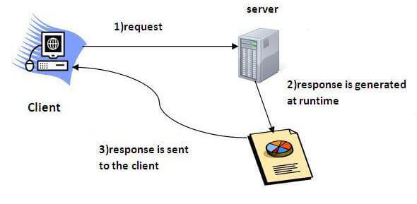
Servlet Introduction
Servlet can be described in many ways, depending on the context.
Servlet is a technology which is used to create a web application.
Servlet is an API that provides many interfaces and classes including documentation.
Servlet is an interface that must be implemented for creating any Servlet.
Servlet is a class that extends the capabilities of the servers and responds to the incoming requests. It can respond to any requests.
Servlet is a web component that is deployed on the server to create a dynamic web page.

Slide 3
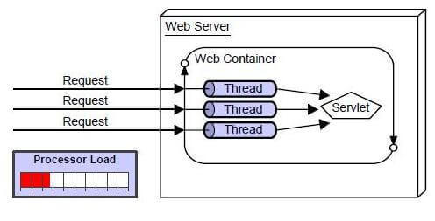
Advantages of Servlet
Better performance: because it creates a thread for each request, not process.
Portability: because it uses Java language.
Robust: JVM manages Servlets, so we don't need to worry about the memory leak, garbage collection, etc.
Secure: because it uses java language.

Slide 4
Servlet API
The javax.servlet and javax.servlet.http packages represent interfaces and classes for servlet api.
The javax.servlet package contains many interfaces and classes that are used by the servlet or web container. These are not specific to any protocol.
The javax.servlet.http package contains interfaces and classes that are responsible for http requests only.

Slide 5
Http Servlet Class
The HttpServlet class extends the GenericServlet class and implements Serializable interface. It provides http specific methods such as doGet, doPost, doHead, doTrace etc
protected void processRequest (HttpServletRequest req, HttpServletResponse res) receives the request from the service method, and dispatches the request to the doXXX() method depending on the incoming http request type.
protected void doGet (HttpServletRequest req, HttpServletResponse res) handles the GET request. It is invoked by the web container.
protected void doPost (HttpServletRequest req, HttpServletResponse res) handles the POST request. It is invoked by the web container.
protected void doHead (HttpServletRequest req, HttpServletResponse res) handles the HEAD request. It is invoked by the web container.

Slide 6
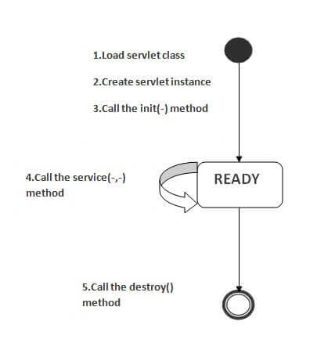
Servlet Life Cycle
Servlet class is loaded - The class loader is responsible to load the servlet class. The servlet class is loaded when the first request for the servlet is received by the web container.
Servlet instance is created - The web container creates the instance of a servlet after loading the servlet class. The servlet instance is created only once in the servlet life cycle.
init method is invoked - The web container calls the init method only once after creating the servlet instance. The init method is used to initialize the servlet. It is the life cycle method of the javax.servlet.Servlet interface
service method is invoked - The web container calls the service method each time when request for the servlet is received. If servlet is not initialized, it follows the first three steps as described above then calls the service method. If servlet is initialized, it calls the service method. Notice that servlet is initialized only once.
destroy method is invoked - The web container calls the destroy method before removing the servlet instance from the service. It gives the servlet an opportunity to clean up any resource for example memory, thread etc.

Slide 7
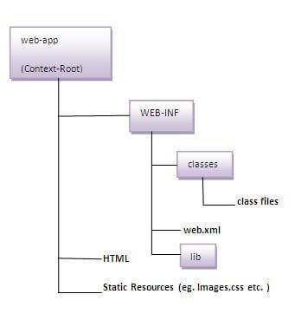
Directory Structure of Apache Tomcat Server
The directory structure defines that where to put the different types of files so that web container may get the information and respond to the client.
The Sun Microsystem defines a unique standard to be followed by all the server vendors. Let's see the directory structure that must be followed to create the servlet.
As you can see that the servlet class file must be in the classes folder. The web.xml file must be under the WEB-INF folder.

Slide 8
Servlet Request Object
An object of ServletRequest is used to provide the client request information to a servlet such as content type, content length, parameter names and values, header information, attributes etc.
Method | Description
public String getParameter (String name) | is used to obtain the value of a parameter by name.
public String[] getParameterValues (String name) | returns an array of String containing all values of given parameter name. It is mainly used to obtain values of a Multi select list box.
java.util.Enumeration getParameterNames() | returns an enumeration of all of the request parameter names.

Slide 9
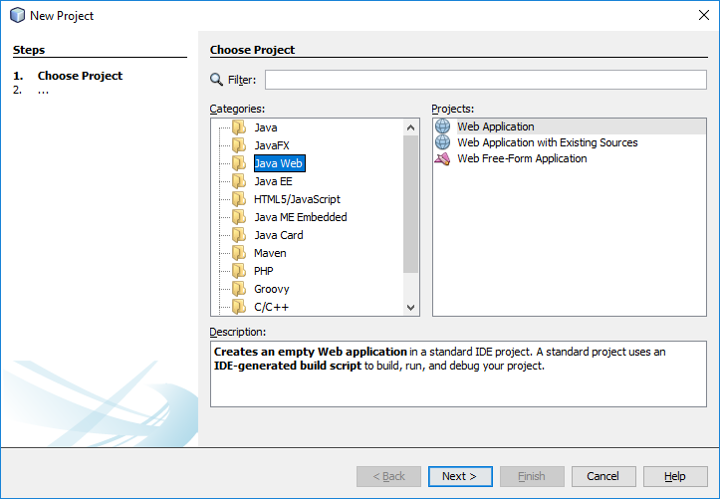
Servlet Creation in NetBeans
Click Create Project, then choose JavaWeb in categories, Web Application in projects then click next

Slide 10
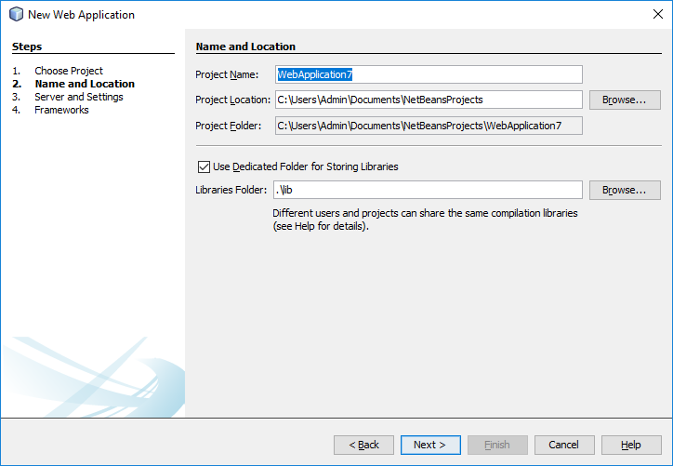
Servlet Creation in NetBeans
Provide a name to the Project, then click next

Slide 11
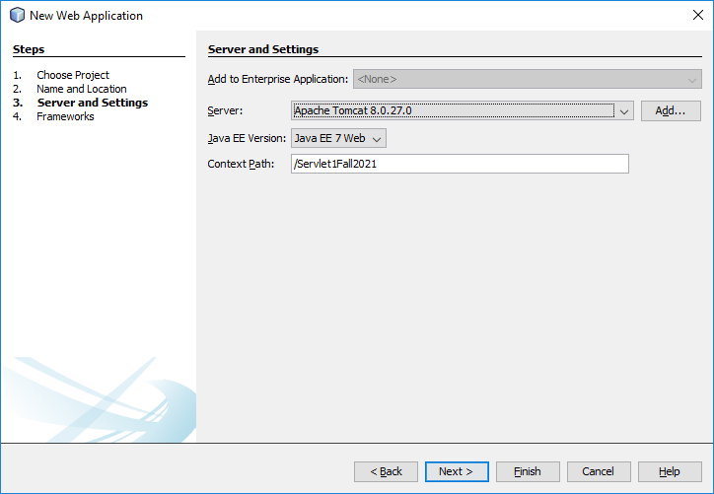
Servlet Creation in NetBeans
Now check, that the Apache Tomcat/Glass Fish Server is selected, verify the java EE version and context path as shown in the below figure. Then click finish.

Slide 12
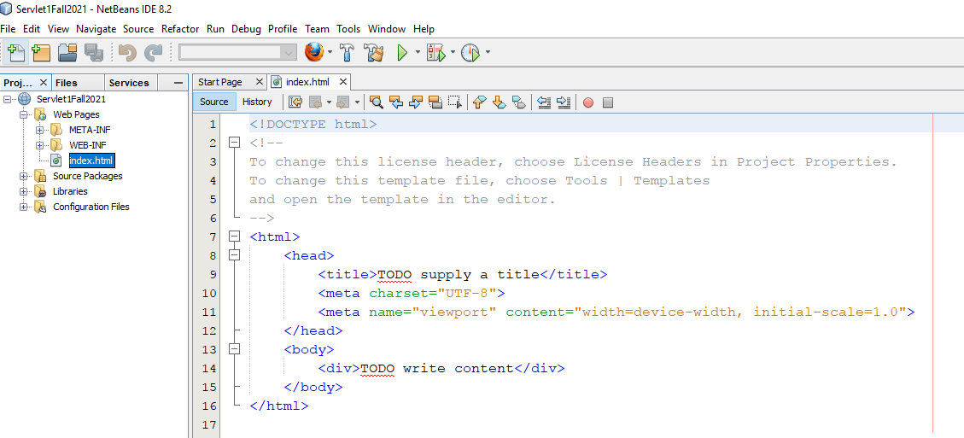
Servlet Creation in NetBeans
The Project is created with index.html as initial page to deploy. Can have the html form content here

Slide 13
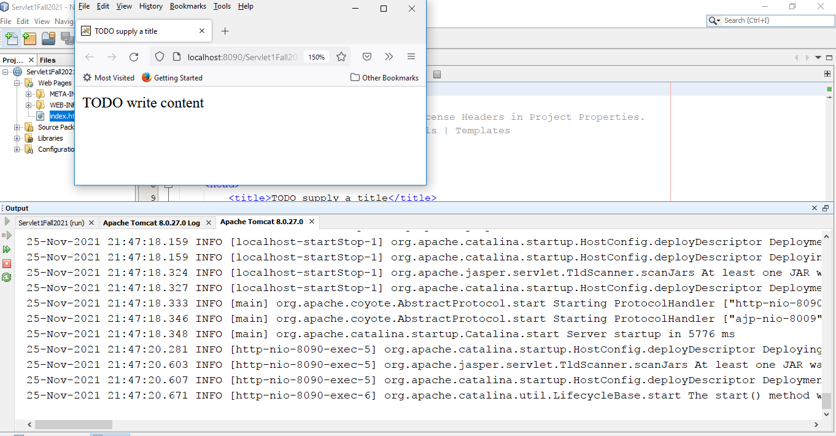
Deploy Servlet
The output is shown in browser after deployment of the project as shown below:
Output

Slide 14
Example
index.html
<form action="welcome" method=“post">
Enter your name<input type="text" name="name"><br>
<input type="submit" value="login">
</form>
welcome.java
import java.io.*;
import javax.servlet.ServletException;
import javax.servlet.http.*;
void processRequest(HttpServletRequest request, HttpServletResponse response)
throws ServletException, IOException {
response.setContentType("text/html;charset=UTF-8");
try (PrintWriter out = response.getWriter()) {
String name = request.getParameter(“uname”);
out.println(“Welcome “+ name);
}
}

Slide 15
Servlet Packages
Servlets can be created using the javax.servlet and javax.servlet.http packages, which are a standard part of the Java's enterprise edition, an expanded version of the Java class library that supports large-scale development projects.
By default, a servlet application is located at the path <Tomcat-installation-directory>/webapps/ROOT.
The class file would reside in <Tomcat-installation-directory>/webapps/ROOT/WEB-INF/classes.
If you have a fully qualified class name of com.myorg.MyServlet, then this servlet class must be located in WEB-INF/classes/com/myorg/MyServlet.class.

Slide 16
Updates in web.xml
<servlet>
<servlet-name>HelloWorld</servlet-name>
<servlet-class>HelloWorld</servlet-class>
</servlet>
<servlet-mapping>
<servlet-name>HelloWorld</servlet-name>
<url-pattern>/HelloWorld</url-pattern>
</servlet-mapping>

Slide 17
Servlet Structure
import java.io.*;
import javax.servlet.*;
import javax.servlet.http.*;
public class <servlet class name> extends HttpServlet
{
protected void processRequest (HttpServletRequest request, HttpServletResponse response)
throws ServletException, IOException {
code }
public void doGet (HttpServletRequest req, HttpServletResponse res) throws ServletException, IOException {
processRequest(request, response); }
public void doPost (HttpServletRequest req, HttpServletResponse res) throws ServletException, IOException {
processRequest(request, response); }
}

Slide 18
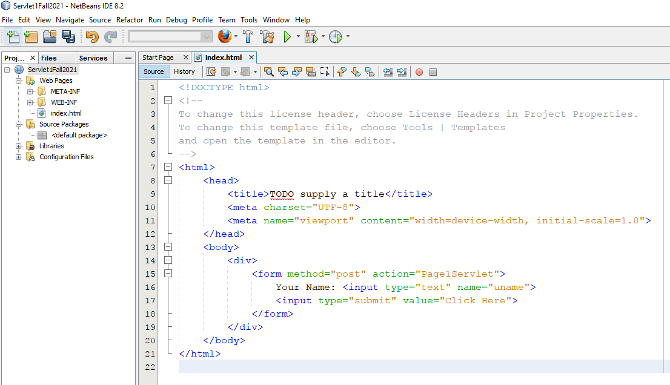
Update Index.html
Updated index.html to collect user name with a submit button

Slide 19
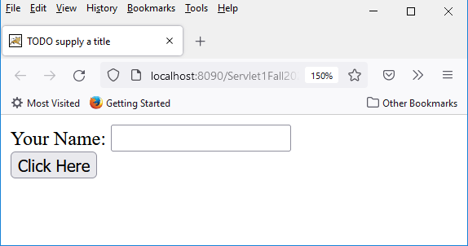
Servlet Output Window
The output of updated index.html

Slide 20
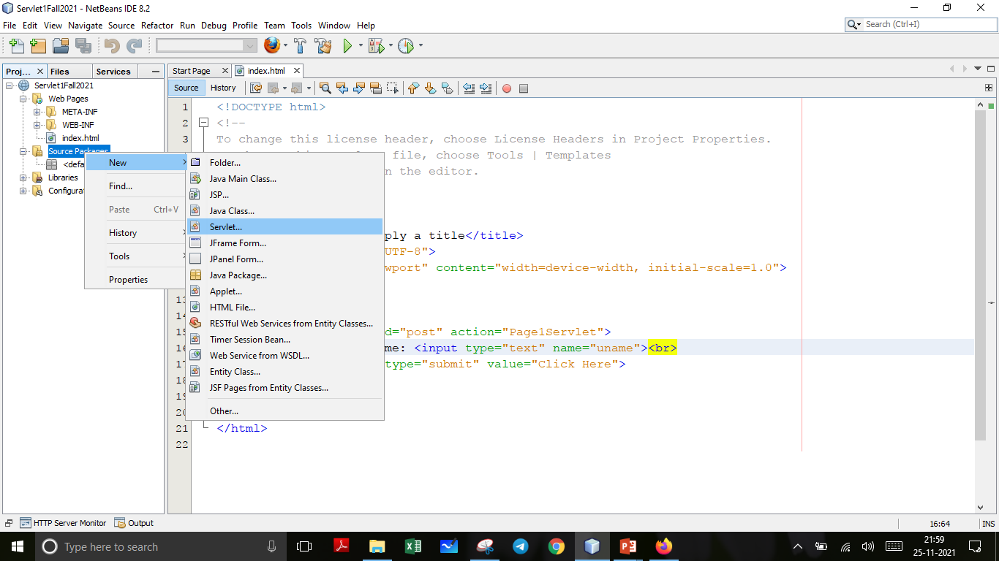
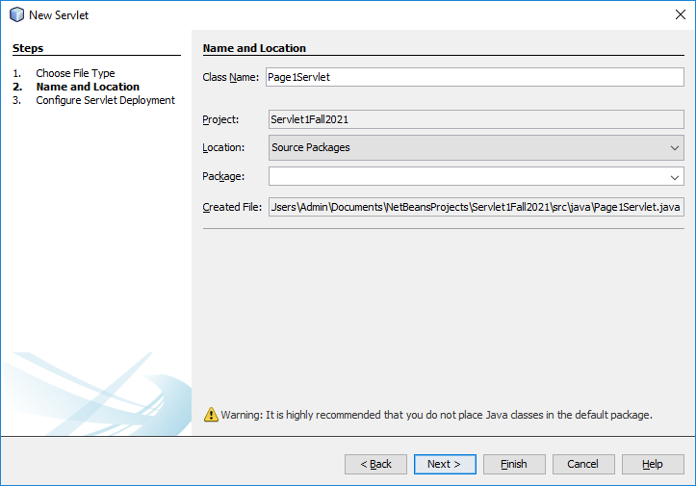
Create a Servlet Page
Right Click Source pages under the project menu -> new -> Servlet
Give a name in the “Class Name” as shown below, then click “next”

Slide 21
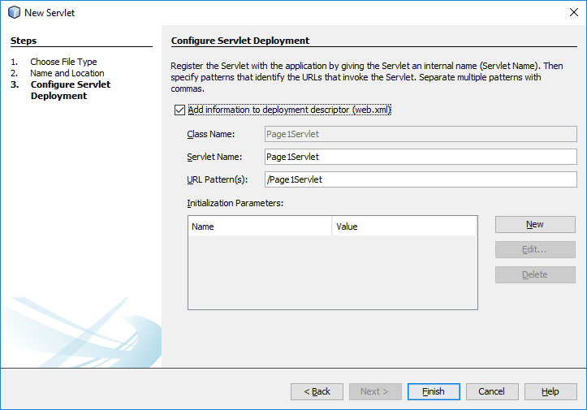
Create a Servlet Page
Now check the “Add information…” as shown in the figure and click “finish”.

Slide 22
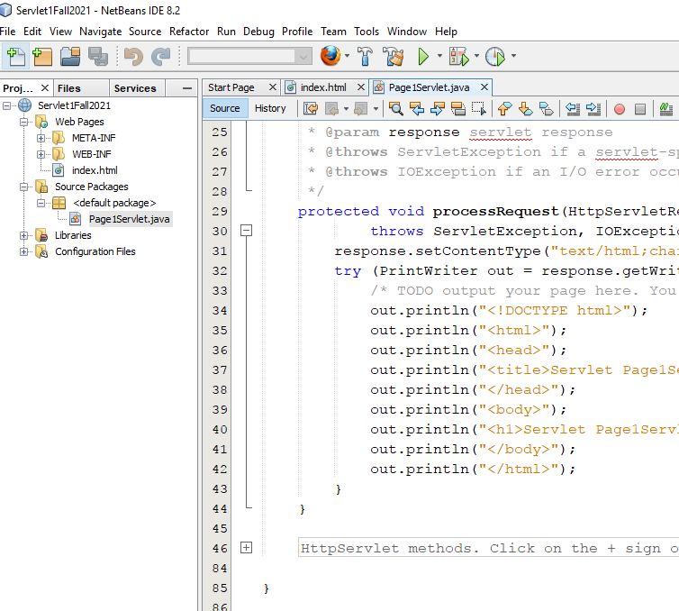
Servlet Code
The servlet page is created as shown in the figure and the code can be written.
Code Window

Slide 23
Servlet Code Template
protected void processRequest (HttpServletRequest request, HttpServletResponse response)
throws ServletException, IOException {
response.setContentType("text/html;charset=UTF-8");
try (PrintWriter out = response.getWriter()) {
/* TODO output your page here. You may use following sample code. */
out.println("<!DOCTYPE html>");
out.println("<html>");
out.println("<head>");
out.println("<title>Servlet Page1Servlet</title>");
out.println("</head>");
out.println("<body>");
out.println("<h1>Servlet Page1Servlet at " + request.getContextPath() + "</h1>");
out.println("</body>");
out.println("</html>");
}
}

Slide 24
Servlet Parameters
Servlet output is displayed on the browser. HTML tags are created to show the outputs and this tag can be included in Servlet output statement.
response.setContentType("text/html;charset=UTF-8"); - used to set the output type
PrintWriter out = response.getWriter() – assigning the output window and this should be handled inside try..catch
out.println() – is the statement for output
Variable = request.getParameter(“parameterName”) – used to get the input from HTML form
Here, request and response are the parameters for HTTPServletRequest and HTTPServletResponse of processRequest method

Slide 25
Servlet Working Scenario
1. The server checks if the servlet is requested for the first time.
2. If yes, web container does the following tasks:
loads the servlet class.
instantiates the servlet class.
calls the init method passing the ServletConfig object
else
calls the service method passing request and response objects
3. The web container calls the destroy method when it needs to remove the servlet such as at time of stopping server or undeploying the project.

Slide 26
Web Container Handles Servlet Request
The web container is responsible to handle the request.
maps the request with the servlet in the web.xml file.
creates request and response objects for this request
calls the service method on the thread
The public service method internally calls the protected service method
The protected service method calls the doGet method depending on the type of request.
The doGet method generates the response and it is passed to the client.
After sending the response, the web container deletes the request and response objects. The thread is contained in the thread pool or deleted depends on the server implementation.

Slide 27
Servlet – Context
An object of ServletContext is created by the web container at time of deploying the project. This object can be used to get configuration information from web.xml file. There is only one ServletContext object per web application.
If any information is shared to many servlet, it is better to provide it from the web.xml file using the <context-param> element.
Usages of Servlet Context:
The object of ServletContext provides an interface between the container and servlet.
The ServletContext object can be used to get configuration information from the web.xml file.
The ServletContext object can be used to set, get or remove attribute from the web.xml file.
The ServletContext object can be used to provide inter-application communication.

Slide 28
Simple Servlet – Example
Index.html
Servlet1.java
<html>
<form action=“Servlet1" method ="post">
<input type="text" name="uname"
placeholder ="User Name">
<input type="number" name="uage"
placeholder="Age">
<input type="submit" value ="Login">
</form>
</html>
protected void processRequest(HttpServletRequest request, HttpServletResponse response) throws ServletException, IOException {
String name;
int age;
response.setContentType("text/html;charset=UTF-8");
try{
PrintWriter out = response.getWriter();
name = request.getParameter("uname");
age = Integer.parseInt(request.getParameter("uage"));
out.print("Welcome "+name);
if (age<18)
out.print(" You are minor");
else
out.print("You are major");
} catch(IOException e){
System.out.println(e);
}
}

Slide 29
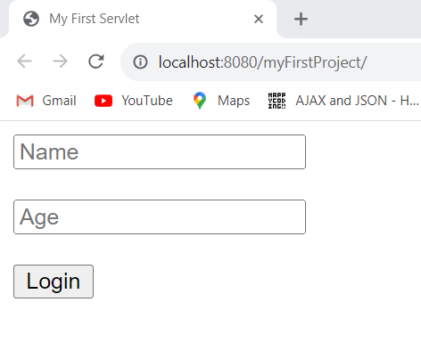
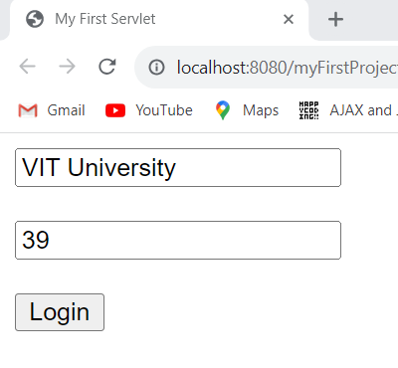
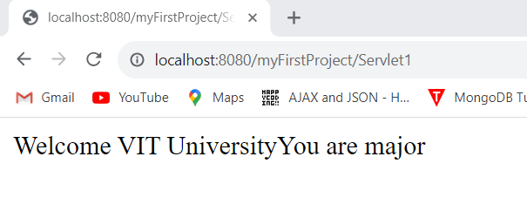
Simple Servlet – Output

Slide 30
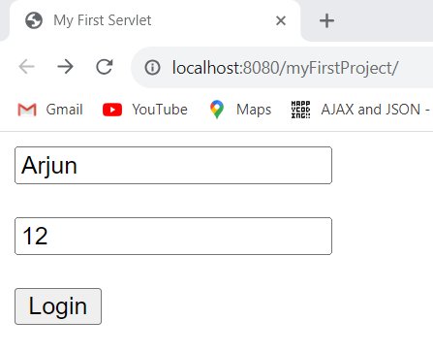
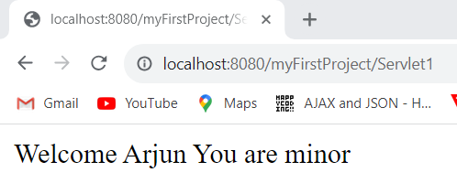
Simple Servlet – Output

Slide 31
Servlet – RequestDispatcher
RequestDispatcher - interface provides the facility of dispatching the request to another resource it may be html, servlet or jsp. This interface can also be used to include the content of another resource also. It is one of the way of servlet collaboration.
Forward – Forwards a request from a servlet to another resource (servlet, JSP file, or HTML file) on the server.
Include – Includes the content of a resource (servlet, JSP page, or HTML file) in the response.

Slide 32
RequestDispatcher – Creation Steps
Steps involved in a request dispatcher:
Create object → RequestDispatcher objectName
Assigning context to the object
objectName = request.getRequestDispatcher(“/path or file name");
objectName.forward(requestObject, responseObject)
(or)
objectName.include(requestObject, responseObject)

Slide 33
RequestDispatcher – Example
Steps involved in a request dispatcher:
Create object → RequestDispatcher rd
Assigning context to the object
rd = request.getRequestDispatcher(“/Page2");
(or)
b. request.getRequestDispatcher(“/index.html");
3. Redirect to the URL
objectName.forward(request, response)
(or)
objectName.include(request, response)

Slide 34
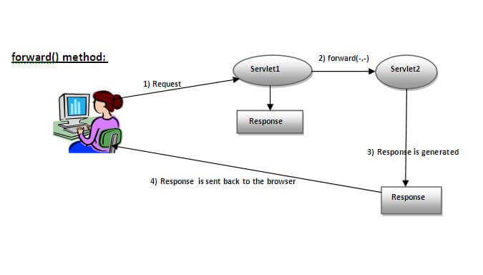
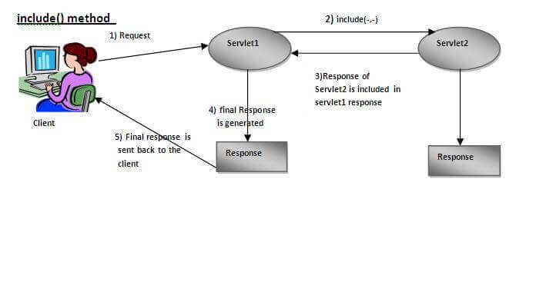
RequestDispatcher – forward vs include

Slide 35
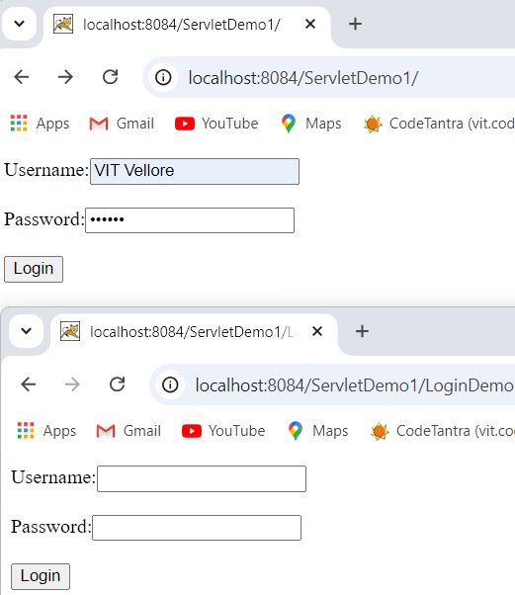
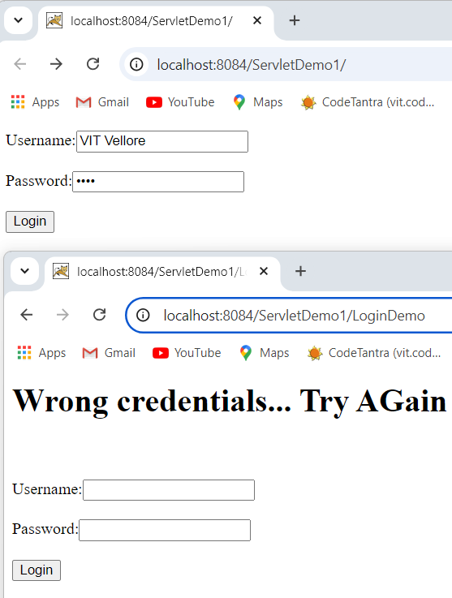
Dispatcher - forward
Dispatcher - include

Slide 36
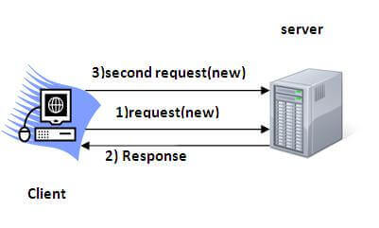
Session Tracking
Session Tracking is a way to maintain state (data) of an user. It is also known as session management in servlet. It is used to recognize the particular user.
Session Tracking Techniques
HttpSession
Cookies
Hidden Form Field
URL Rewriting

Slide 37
Cookie
A cookie is a small piece of information that is persisted between the multiple client requests.
A cookie has a name, a single value, and optional attributes such as a comment, path and domain qualifiers, a maximum age, and a version number.
Types:
Non-persistent cookie - It is valid for single session only. It is removed each time when user closes the browser.
Persistent cookie - It is valid for multiple session . It is not removed each time when user closes the browser. It is removed only if user logout or signout.

Slide 38
Cookie
Advantage of Cookies
Simplest technique of maintaining the state.
Cookies are maintained at client side.
Disadvantage of Cookies
It will not work if cookie is disabled from the browser.
Only textual information can be set in Cookie object.

Slide 39
Cookie
Creating Cookies
Create object to the Cookie class
Add Cookie to the response object
Use request object to access the cookie
Cookie Methods:
Creation → Cookie obj = new Cookie(cookiename, CookieValue);
Send → response.addCookie(obj)
Access → arrObj = request.getCookies();
Iterate the array with getName and getValue methods to retrieve the information.

Slide 40
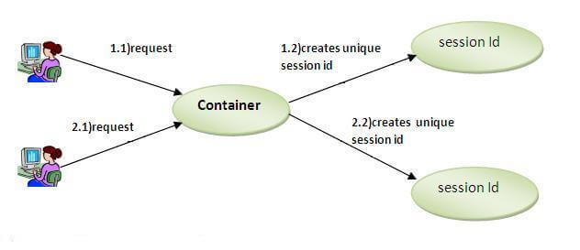
Session
Container creates a session id for each user. The container uses this id to identify the particular user. An object of HttpSession can be used to perform two tasks:
1. Bind objects
2. View and manipulate information about a session, such as the session identifier, creation time, and last accessed time.

Slide 41
HttpSession
Session Creation:
Create a HttpSession object
Get the current session through the request object.
Use setAttribute(id, value) method of session with the parameters session id and value for that.
Use getAttribute(id) to access the session and convert it to the required data type.

